Slide 1
Electric Vehicles Analysis
DATA 230 DATA VISUALIZATION
- By Yashasvi Kotra

Slide 2
Wa-gov--main https://data.wa.gov/Transportation/Electric-Vehicle-Population-Data/f6w7-q2d2/data WHData.gov-- https://catalog.data.gov/dataset/electric-vehicle-population-data
Dataset

Slide 3
Sheets & DashboardsTENTS
01
02
03
04
A glimpse of work
Eligible and Non-Eligible products
Avg Electric Range By vehicles
How many EV’s that are getting manufactured are eligible for Clean alternative Vehicle Program
Battery Electric Vehicles
Vs
Plug- in- Electric vehicles
EV’s Time Series Analysis
Concentration of EV’s
Depicts steady increase of EV’s production over time
EV’s Adoption in Washington

Slide 4
Sheets & DashboardsTENTS
05
06
07
08
A glimpse of work
Distribution of Vehicle type
Year – over – Year Growth
Distribution of Vehicle types based on Electric ranges and count of make.
Yearly growth of EV’s count over years from 1998-2022.
Rankings of Luxury EV’s
Highest Selling EV’s
Rankings w.r.t count, model and overall rankings.
Treemap showing count of EV models.

Slide 5
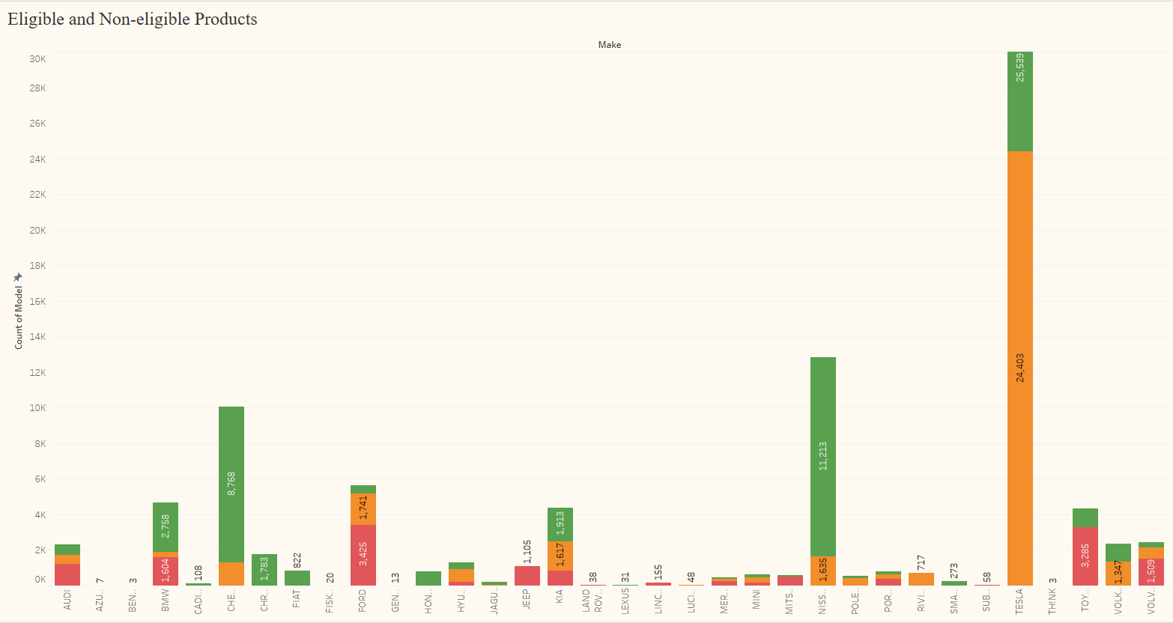

Slide 6
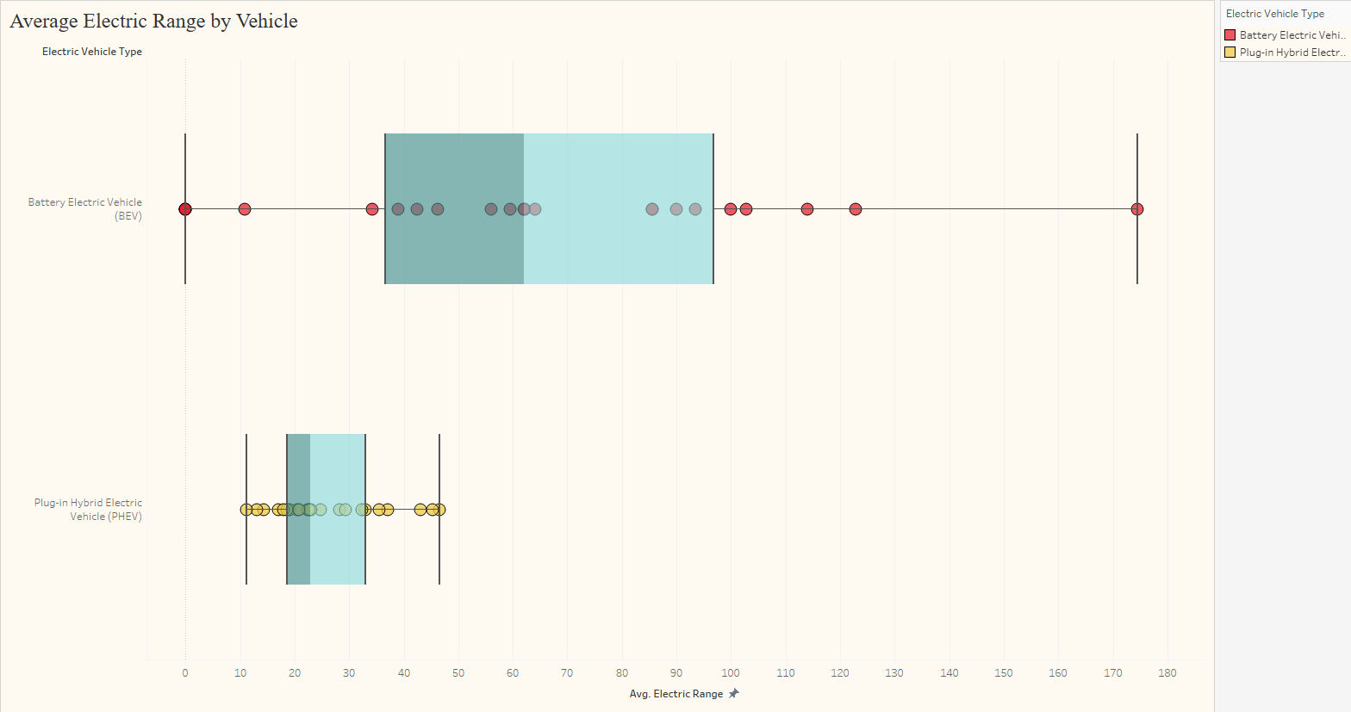

Slide 7
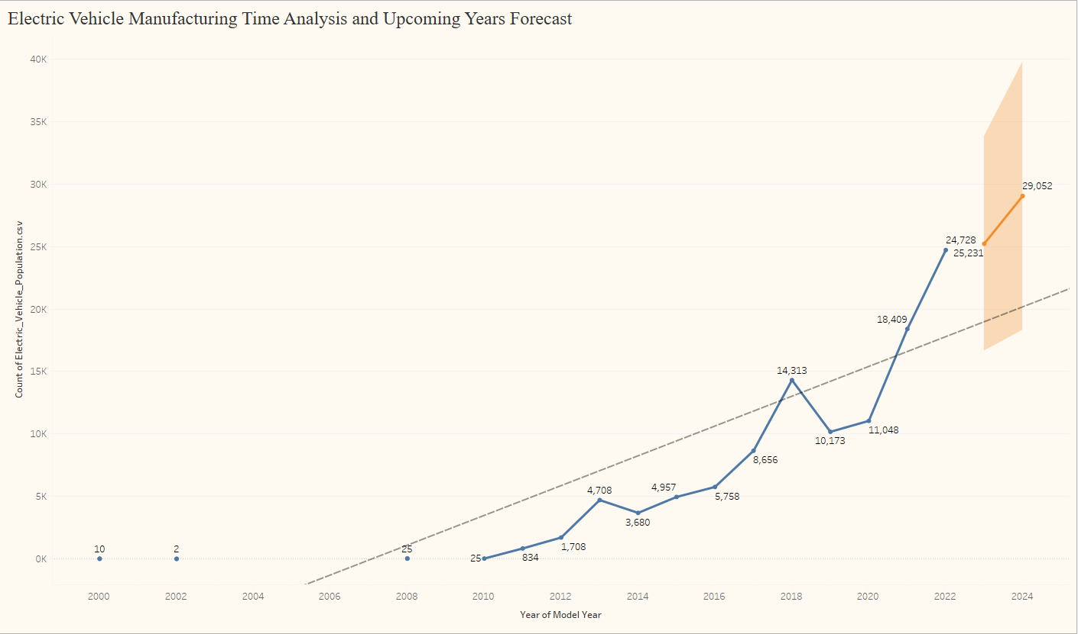
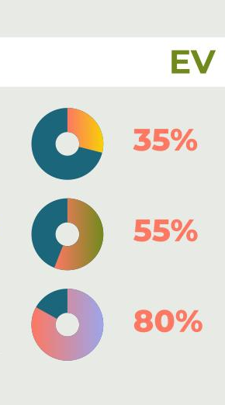

Slide 8
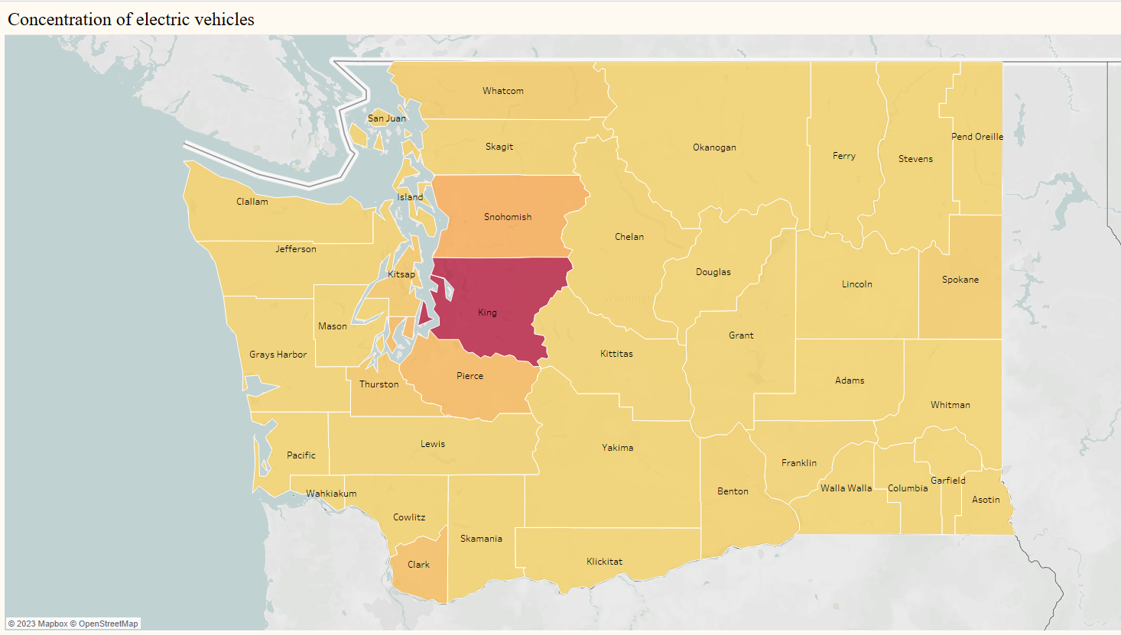

Slide 9
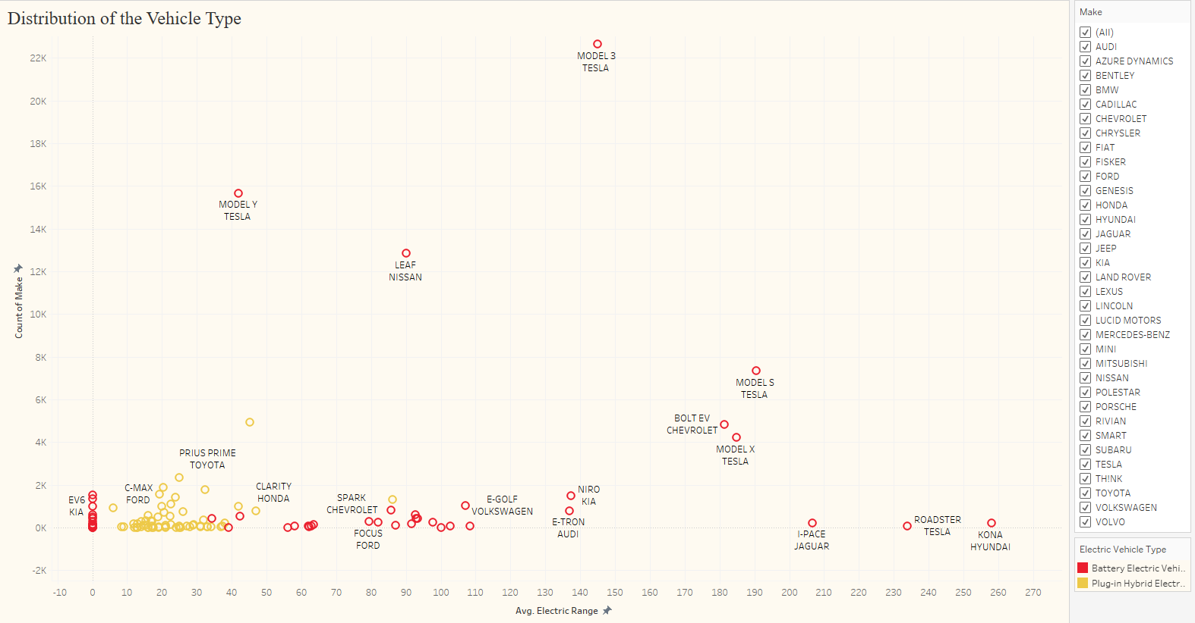

Slide 10
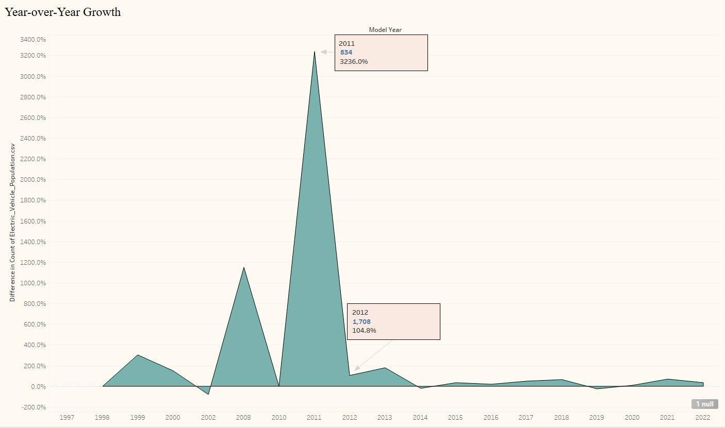

Slide 11
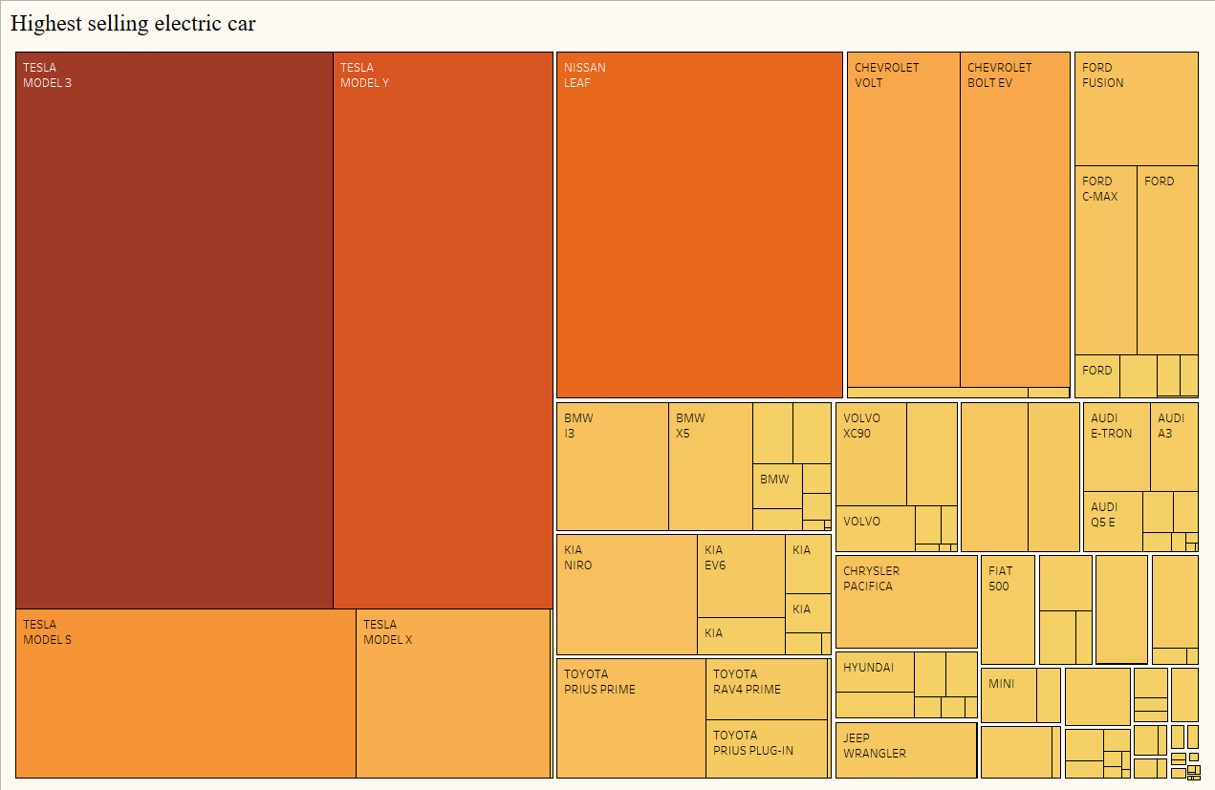

Slide 12
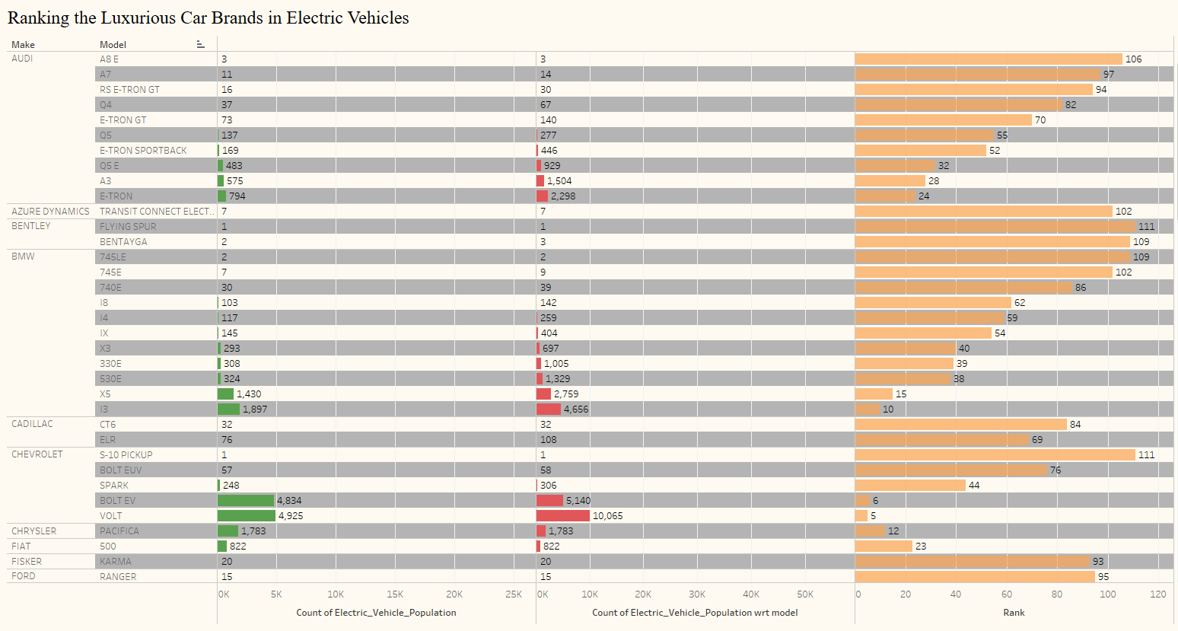

Slide 13
Let’s go to the Tableau Workbooks….ESS
- published the project using D3.js
You can enter a subtitle here if you need it

Slide 14
GO Green!

Slide 15
Thankyou!!

